Slide 1
Vrinda Store Sales Data Analysis 2022
Source For Project Creation is Internet, Youtube

Slide 2

Objective
Vrinda store wants to create an annual sales report for 2022. So that, Vrinda can understand their customers and grow more sales in 2023.

Slide 3
Questions
What is the sales month wise?
Which month got the highest sales?
Who purchased more- men or women in 2022?
What are the different order status in 2022?
List top 5 states contributing to the sales?
Relation between age and gender based on numbers of orders?
Which channel is contributing to maximum sales?
Highest selling category?

Slide 4
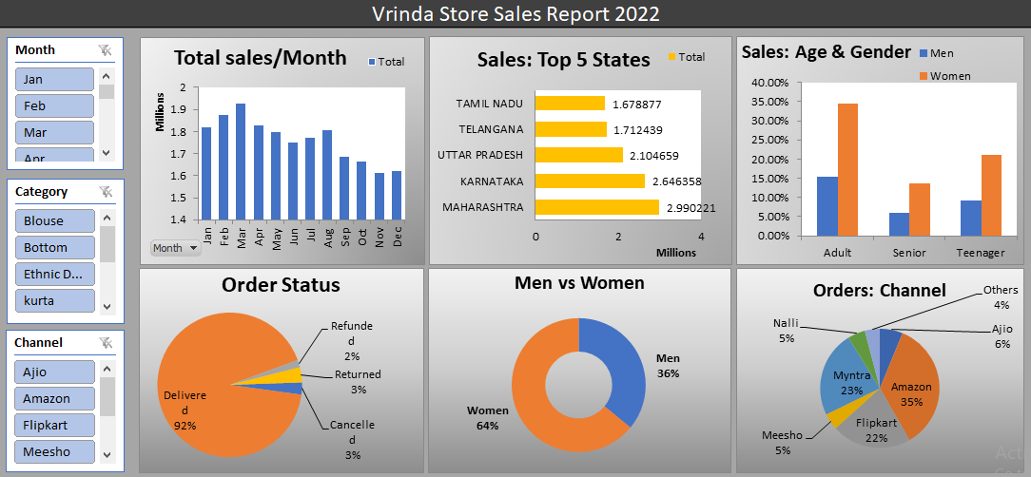

Slide 5
Insights
Women are more likely to buy compared to men(~65%)
Maharashtra, Karnatka and Uttar Pradesh are the top three states(~35%)
Adult age group(30-50 years) is max contributing in sales (~50%)
Amazon, Flipkart, and Myntra channels are max contributing in sales (~80%)

Slide 6
Conclusion
Target women customers of age group(30-50 years) living in Maharashtra, Karnatka and Uttar Pradesh by showing ads/offers/coupons available on Amazone, Flipkart and Myntra.

